Slide 1

Fun with js, nodeJS and mongoDB
By niels robin aagaard
(@nielsrobin)

Slide 2
Agenda
Who @nielsrobin is
Building a restful API in mongo and node
Building a realtime chat system using websockets and node
Javascript is king

Slide 3
Who is this talk for?

Slide 4
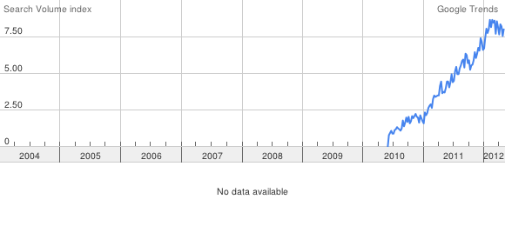
Why node?
”Node.js isn’t a silver bullet, but it’s still a bullet” – Craig Weber

Slide 5
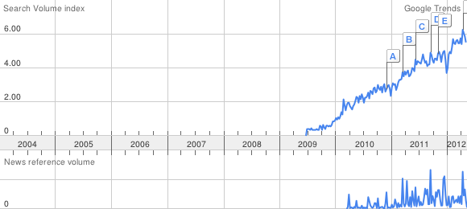
Why mongo?
NoSQL
JSON is document type
Extremely easy access

Slide 6
Setup
Install node (www.nodejs.org)
Use npm for the rest
npm install mongoose
npm install express
Or create a package.json
npm install
Notes:
Test this

Slide 7

node example

Slide 8
Restful API
 | Create | Read | Update | Delete
/Products | Post | Get
/Products/:sku |  | Get | Put | Delete

Slide 9

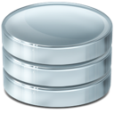




Putting it together
mongoose
expressJS
http
json
json
Client 1
http
json
Client 2
Server

Slide 10
Packages used
Primary
express
mongoose
socket.io
Secondary
underscore
bison

Slide 11
Restful API

Slide 12
Websockets
When ajax is just too slow
Bi-directional communication
Persistant connections
Client 1
Client 2
Client 4
Client 3

Slide 13
Realtime chat system

Slide 14
Couple of cool socket.io examples
http://www.webdigi.co.uk/fun/space/
http://hummingbirdstats.com/
http://apps.kaizenweb.dk/games/bows/play.html

Slide 15
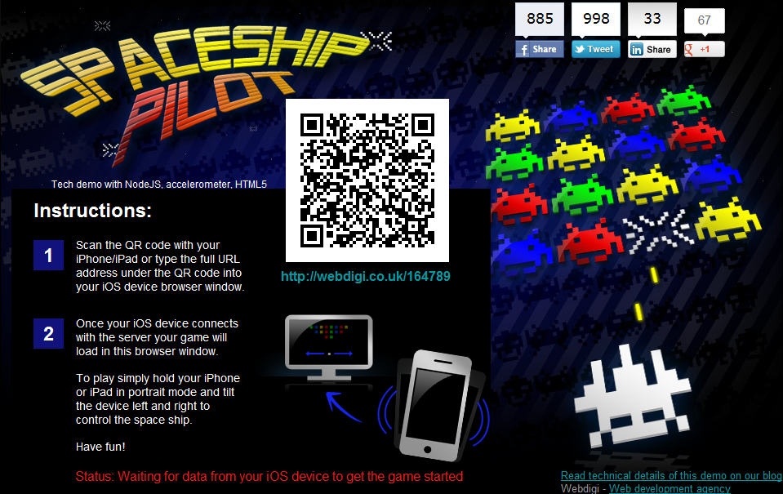

Slide 16
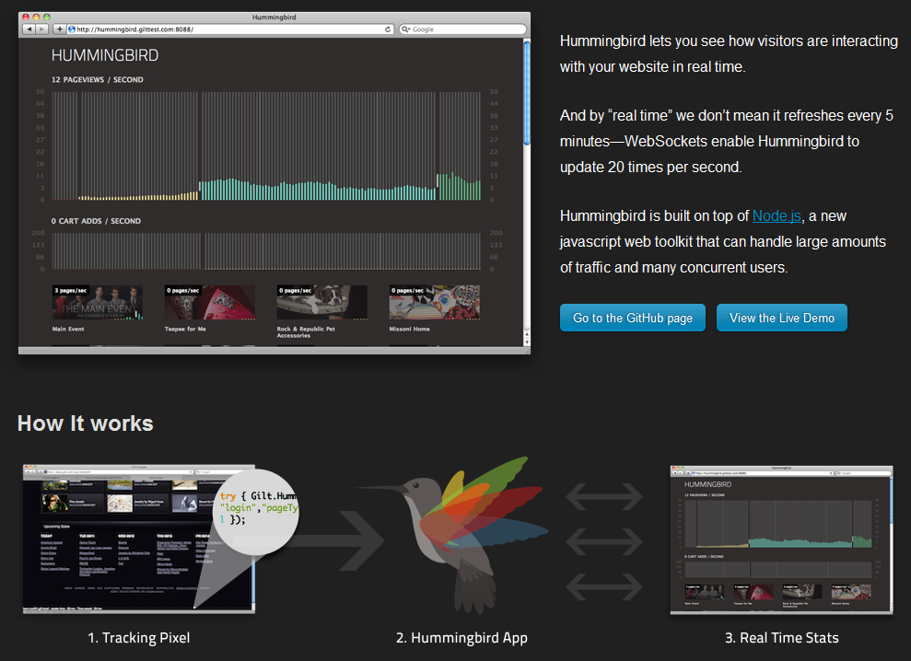

Slide 17
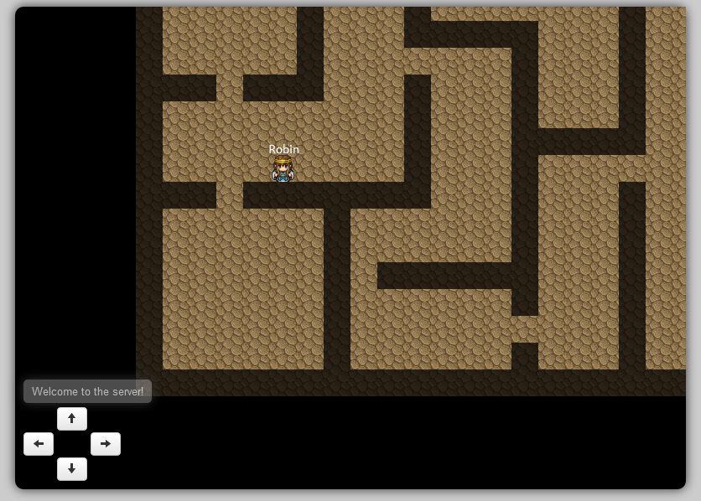

Slide 18
SignalR example (if we have time)

Slide 19
Meteor example (if we have time)

Slide 20
TLTR
Node
Express
Mongoose
Meteor
Socket.IO
Underscore
Bison
SignalR

Slide 21

Questions
Examples are on github: https://github.com/nielsrobin/cdcph2012

Slide 22

http://bit.ly/cd2012c2

